Slide 1
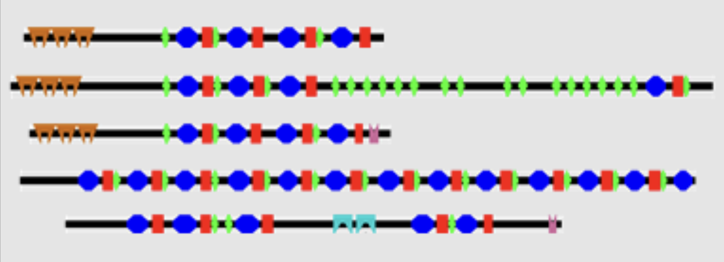
SPARCLE Curation
predicting protein architecture names
2024 NCBI Codeathon - Team Gwadz-Yang
Marc Gwadz (Team Leader), NCBI, NLM, NIH
Mingzhang Yang (Technical Lead), NCBI, NLM, NIH
Christopher Meyer (Writer), University of Chicago - Center for Translational Data Science
Franziska Ahrend, ORISE Fellow NIDDK, NIH
Yixiang Deng, Post-doc MIT, Harvard
Shaojun Xie, Advanced Biomedical and Computational Science, Frederick National Laboratory for Cancer Research

Slide 2
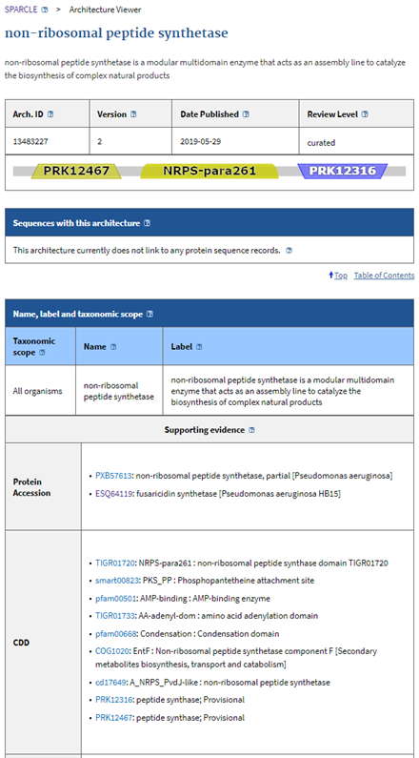
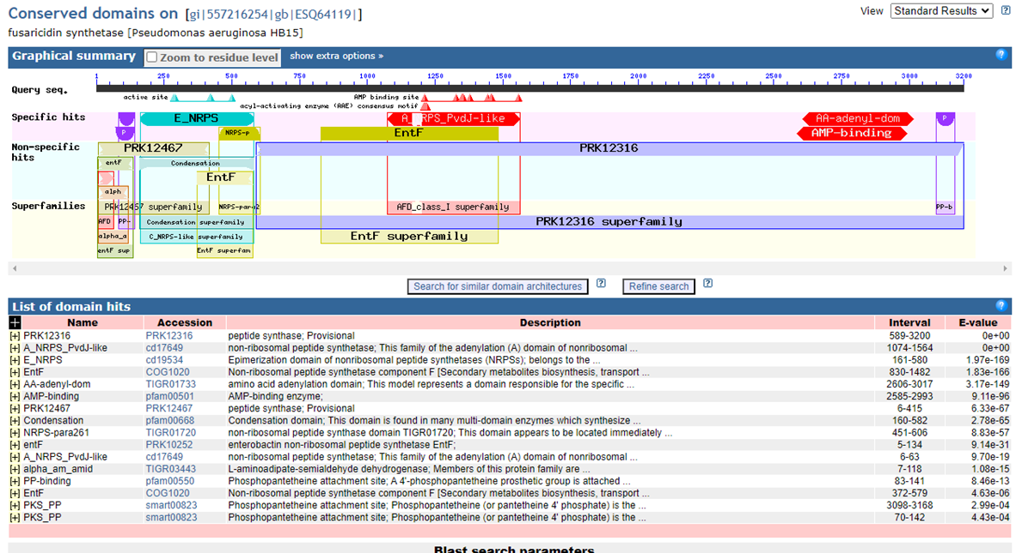
Goal
SPARCLE, the Subfamily Protein Architecture Labeling Engine, is a resource for the functional characterization and labeling of protein sequences that have been grouped by their characteristic conserved domain architecture.
A domain architecture is defined as the sequential order of conserved domains in a protein sequence.
Conserved domains can be clustered into superfamilies that generate over-lapping annotations on the same protein
Goal: Develop Machine Learning methods to use curated architectures to apply names (and other information) to un-curated architectures
Input/processing
Model
Evaluation
Inference
Future Work

Slide 3
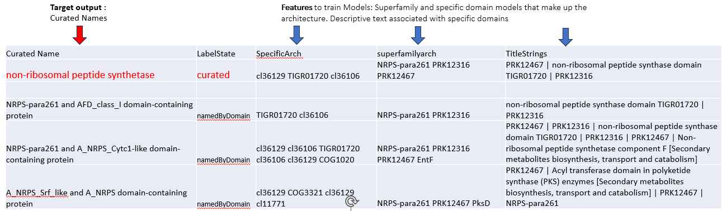
Goal
Input Features: SuperFamilies, Specific Architectures, Title Strings
Output : Curated Names
Input/processing
Model
Evaluation
Inference
Pre-processing :
Curated Names were manually reduced to decrease # categories and help in testing.
Common / uninformative words in TitleStrings (articles, prepositions, “protein” etc.) were eliminated prior to vectorization.
Input/Output Data organized into One-Hot encoded matrices and vectors (SentencePiece)
Future Work

Slide 4
Goal
Preparation of the features and outputs
Input/processing
Strategy A: One-Hot encoding for features
features size [48297] (Superfamilies, Specific CDs)
outputs as curated name strings
Strategy B: Label encoding and Tokenization
feature size [450] (Superfamilies, Specific CDs, TitleStrings)
outputs as curated name strings or tokenized vector (size: 60)
Model
Evaluation
Inference
Future Work

Slide 5
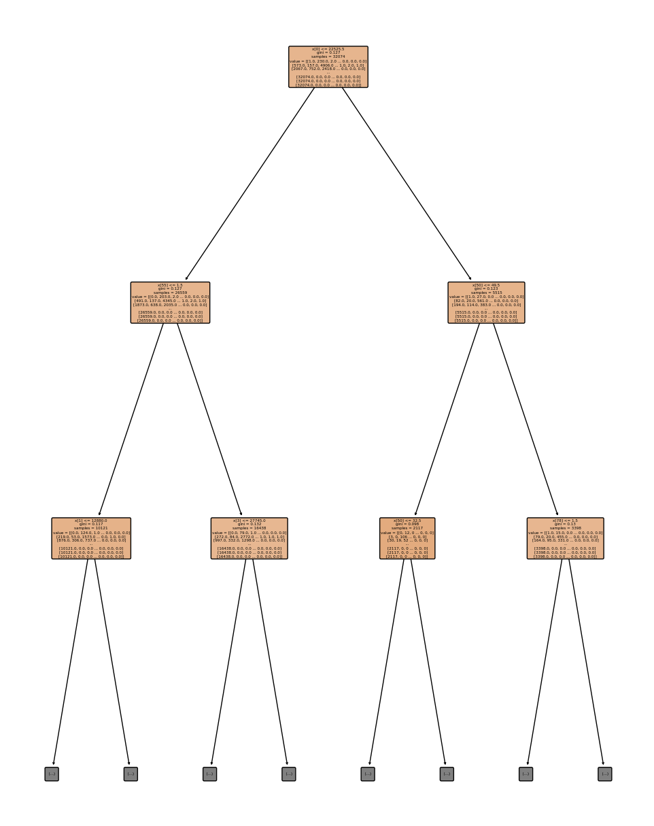
Goal
Decision Tree
Interpretability and Transparency
Categorical Data Handling
Reveals Feature Importance
Models Non-Linear
Relationships
Input/processing
Model
Evaluation
Inference
Future Work

Slide 6
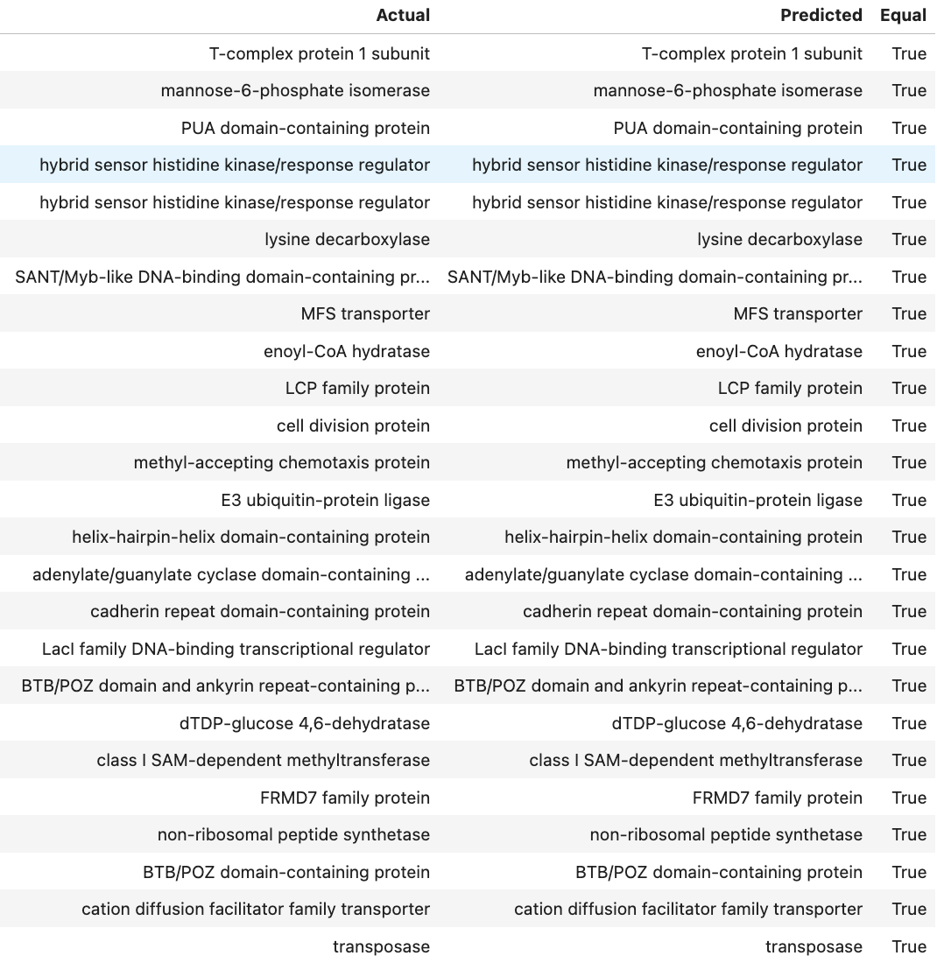
Accuracy
Goal
Perfect match: >32%
Input/processing
Model
Evaluation
Inference
Future Work

Slide 7
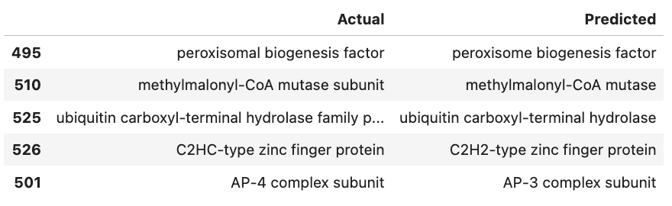
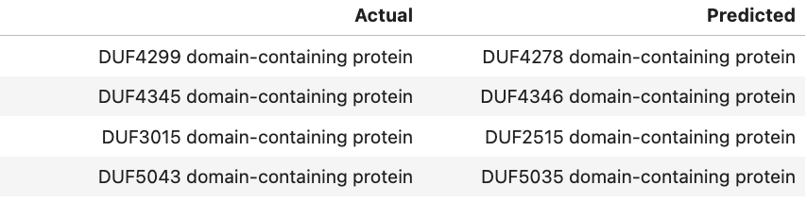
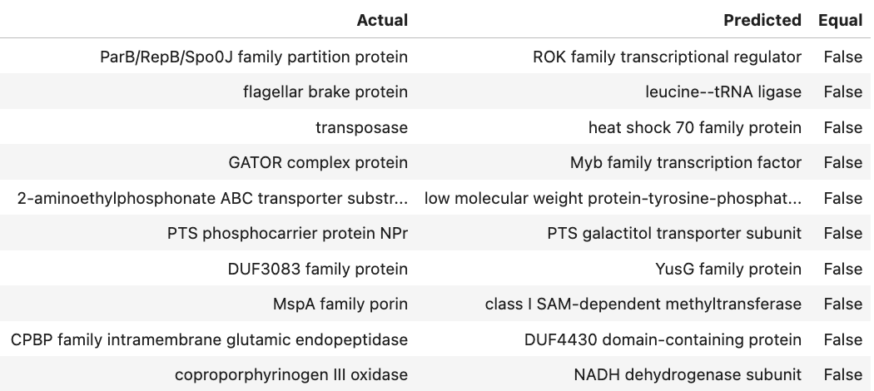
Accuracy
Goal
Perfect match: >32%
String matching algorithms can help identify similar but non-identical text output
(e.g. Fuzzwuzzy ratios, Jaccard similarity)
Close matches may or may not be biologically significant (such as Domains of Unknown function with similar names)
Testing can help identify words to remove from text-based features
Input/processing
Similar match: 39%
Model
Evaluation
Inference
Future Work

Slide 8
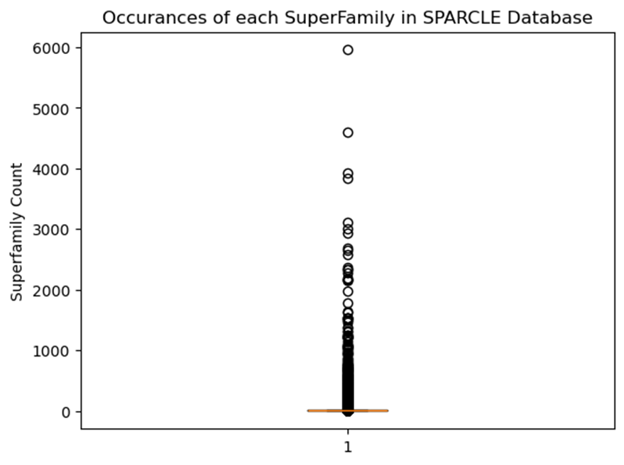
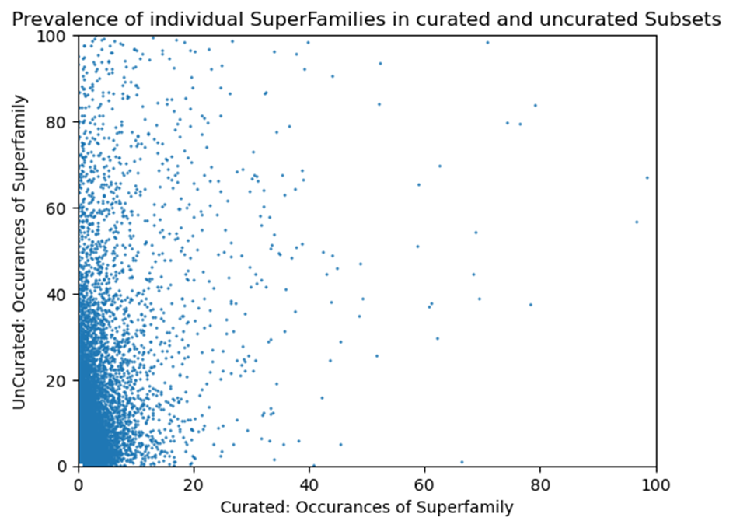
Challenges for training/testing :
- Sparse data (many architectures only have rare superfamilies )
- Large number of categories and some inconsistencies in Curated names
While most super superfamilies occur in very few Architectures, others can occur many times in both curated and uncurated Architectures.
Architectures with frequently occurring superfamilies can hopefully be leveraged to auto-name numerous related architectures.
Goal
Input/processing
Model
Evaluation
Inference
Future Work

Slide 9
Goal
Standardized/generic target names
Collect all the information / knowledge about every domain model to create a corpus.
With this corpus, we can generate word embedding for every single domain model.
Then we can create biologically meaningful vectors for the specificArch and superfamilyArch.
Try other ML methods and employ better validation methods
Parameter optimization: change “opt” variable to use different regressors.
We used “Ridge regression” (opt=ridge), a linear model with performance score R² = 0.25.
This is fastest, but would love to evaluate other methods.
Evaluate choice and filtering of input features
e.g. limiting text to informative strings
Curator inspection of proposed names for uncurated data
Input/processing
Model
Evaluation
Inference
Future Work

Slide 10
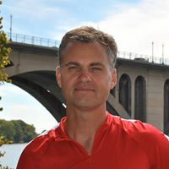
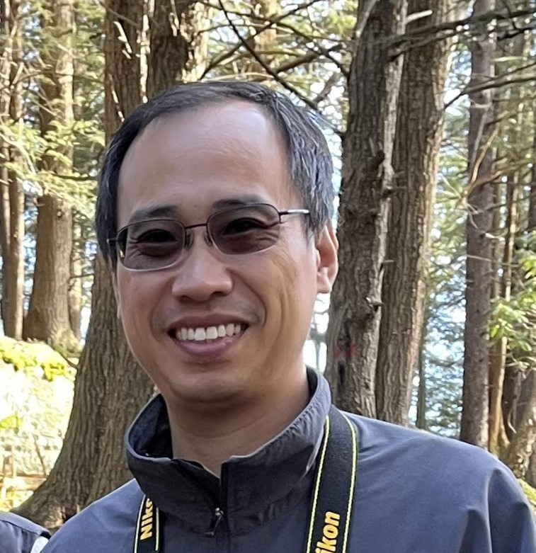
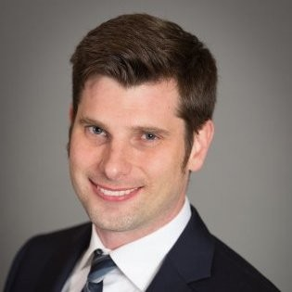
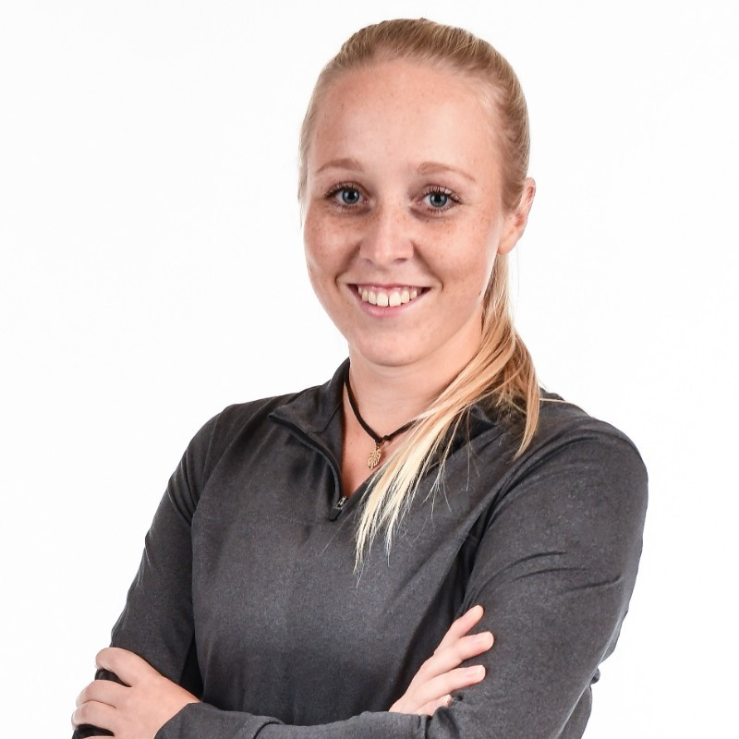
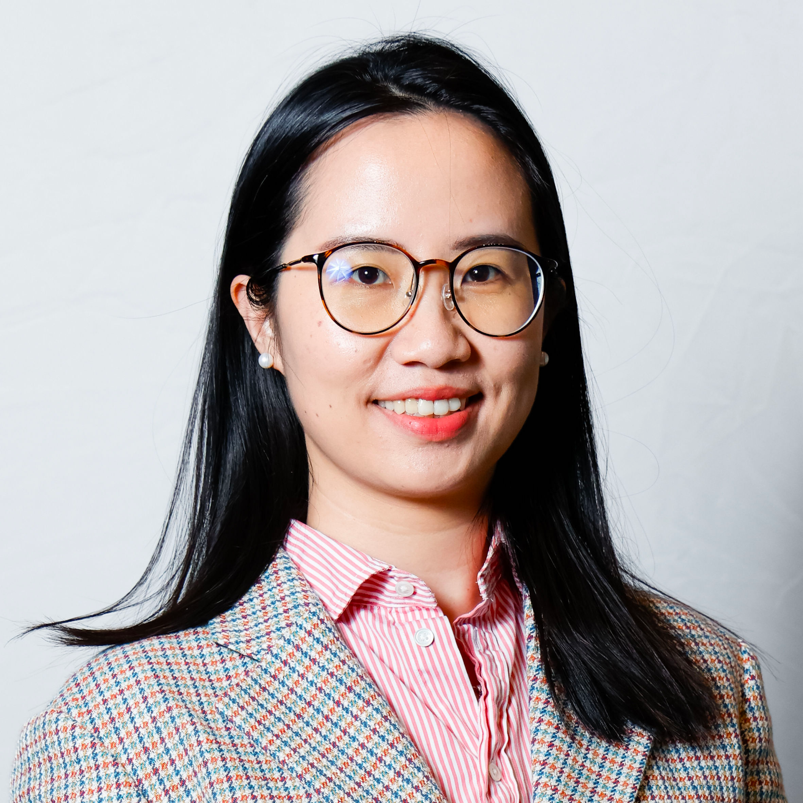
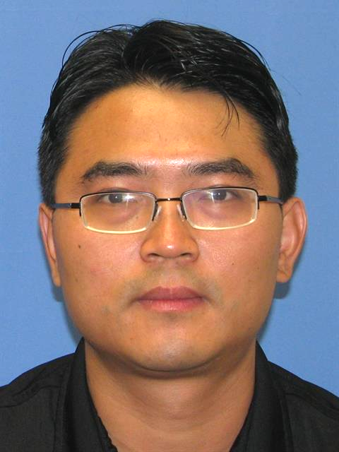
Team Leader
Marc Gwadz
Technical Lead
Mingzhang Yang
Writer
Christopher Meyer
#team-gwadz-yang
Franziska Ahrend
Yixiang Deng
Shaojun Xie
Marc Gwadz, Affiliation (Team Leader) NCBI, NLM, NIH
Mingzhang Yang, Affiliation (Technical Lead) NCBI, NLM, NIH
Christopher Meyer, University of Chicago (Writer)
Franziska Ahrend, ORISE Fellow NIDDK, NIH
Yixiang Deng, Affiliation Post-doc MIT, Harvard
Shaojun Xie, Advanced Biomedical and Computational Science, Frederick National Laboratory for Cancer Research, Frederick, MD, USA.

